Slide 1

Graded Assignment #1
Candidate Testing
Ask candidate to enter their name
Use a loop to ask 5 questions
Check answers for accuracy
Calculate and display results
Do each part in order

Slide 2

Codergirl – WebDev Unit
Class 3
March 17, 2021

Slide 3


Agenda
Kahoot
Studio review
Strings and Arrays
Coding and Exercises
Studio

Slide 4
Studio review
Goal Setting and Getting into the Right Mindset
Your goals for taking this class. You probably have many reasons why this class is
something you want to complete. Please share 1 to 2 of your goals and keep them SMART!
Your goals for your career.
How does this class assist you in your career and where do you want to go?
Please share 1 to 2 goals for your career.
Your inspirational statements.
This can be anything that motivates you from stories to quotes to ideas. Please share 1 to 2.
After the studio, make sure to write your goals and inspirational statements somewhere
where you will regularly see them!

Slide 5
Last Week Q&A
Questions?
Booleans
Logical operators
Conditionals

Slide 6
Review - Collections
Collections
  Data types that bind data together
  Every language has them
  Different collection types have different use cases
JS collections for now:
  Strings
  Arrays

Slide 7
Review - Strings
Strings == text
Collection of characters
  'char' data type doesn't exist in JS
  Ordered collection – items (characters) are stored
  in a specific order
  Each character can be accessed by index
Immutable – Data cannot be changed
Notes:
https://developer.mozilla.org/en-US/docs/Web/JavaScript/Reference/Global_Objects/String#static_methods
It is important to notice that immutability applies to string values and not string variables.

Slide 8
Review – Using Strings
Bracket Notation
  thisIsAString[3] == 's'
  Always start from zero
String concatenation
  const name = ‘Chetna'
  'Hello, ' + name
Template literal
  const name = ‘Chetna'
  'Hello, ${name}'

Slide 9
Review – Strings as Objects
Object – Collection of related data and operations
  Method – Operation that can be carried out on an object
String methods
  Allow us to carry out operations with string value
  Does not change a stored value
    Can save return to a new variable

Slide 10
Review – Arrays
Ordered collection for all datatypes and objects
  Arrays can hold multiple types of data at one time
  Length is not fixed
  Mutable - Can change and remove stored data
Arrays are objects
  Methods can return or alter data

Slide 11
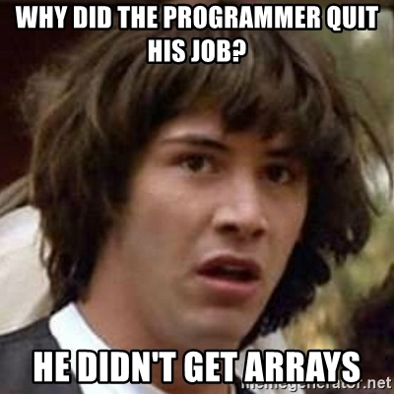
Review – Multi-Dimensional Arrays
Arrays in arrays
Access data via bracket notation

Slide 12
Review – Strings and Arrays
Questions?

Slide 13
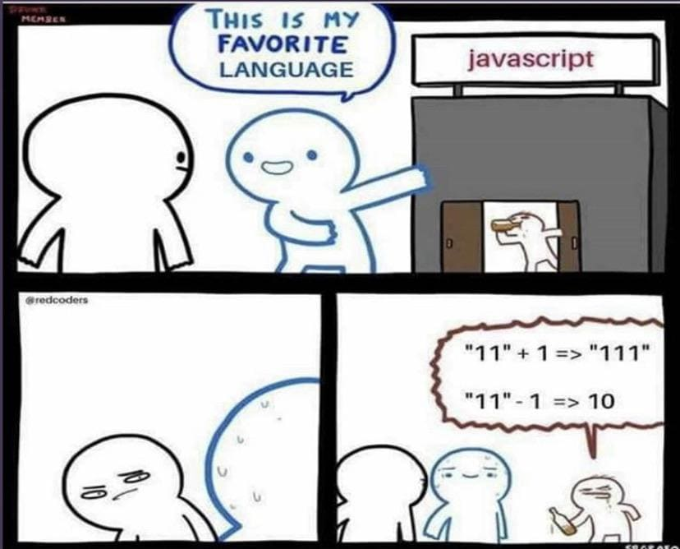
Live Coding

Slide 14
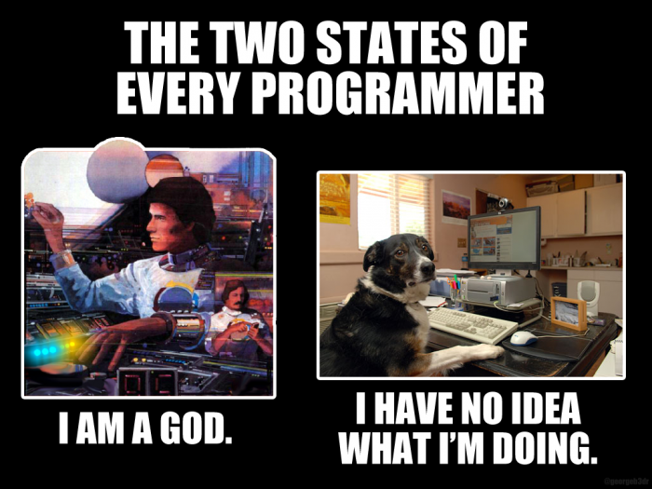
Now
Find your group Zoom
  Studio
  Prep for next week
Studio Review
  WEDNESDAY

